Slide 1


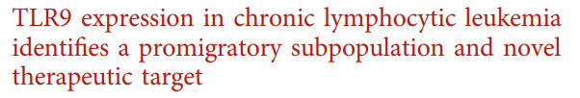
Dr. Emma Kennedy
March 2022

Slide 2
CLL cell migration (trafficking)
Tissue-resident CLL cells
Activated phenotype
Survival/proliferation
Therapy evasion
CLL-cell
T-cells
Antigen
Cytokines/
Chemokines
Macrophages
Stromal cells
Circulating CLL cells
Non-proliferative
Vulnerable to therapy
CLL-cells
Herishanu et al 2011
Patten et al 2008
Buggins et al 2010
Pasikowska et al 2016

Slide 3
B-cell receptor signalling
BCR
CD79a
CD79b
Cell
membrane
BLNK
BTK
ibrutinib
LYN
SYK
PLGC
BCR-Pathway
Releases tissue resident CLL cells
Induces apoptosis
CARD11
MyD88
MALT1
BCL10
IRAK1
IRAK4
Not curative
Residual disease
Resistance and relapse
TRAF6
NF-𝛋B
Cell proliferation
Migration
Survival
Need novel targets/ alternate pathways
IL-6
IL-10
JAK
STAT
Adapted from:
Akhter et al. Journal of Neuro-oncology 121, pages 289–296 (2015)

Slide 4
Toll-like receptor signalling
TLRs
TLR2
TLR4
TLR6
TLR5
Cell
membrane
TLR8
TLR3
TLR-Pathway
TLR9
TLR7
MyD88
TLR9 is a potential candidate for a dual targeted approach to therapy
IRAK1
IRAK4
TRAF6
NF-𝛋B
Cell proliferation
Migration
Survival
IL-6
IL-10
JAK
STAT
Adapted from:
Akhter et al. Journal of Neuro-oncology 121, pages 289–296 (2015)

Slide 5
Aim 1
1. To investigate whether CLL patient plasma contains cell-free DNA

Slide 6
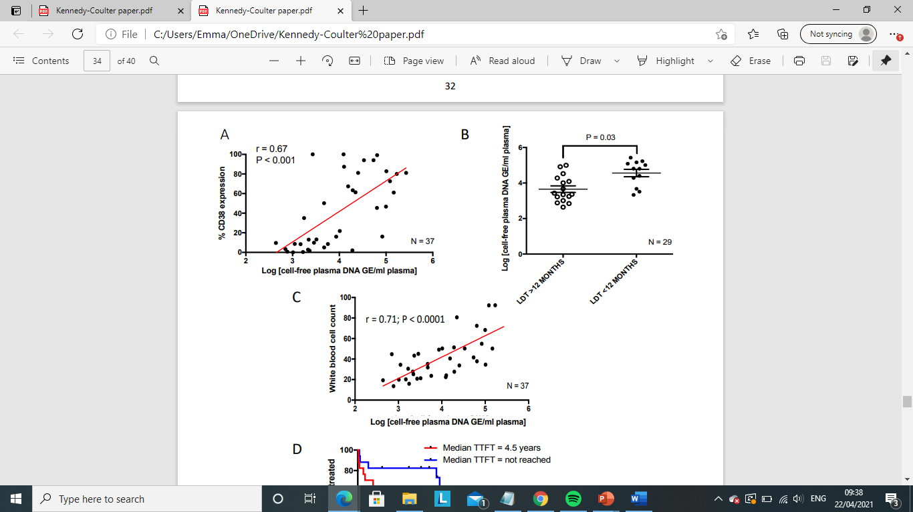
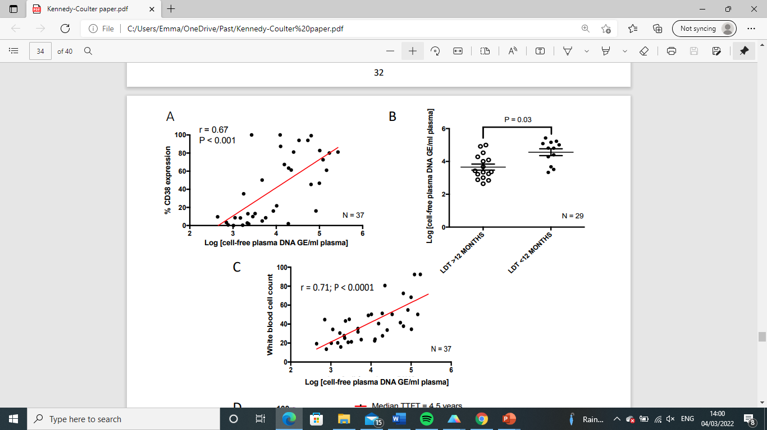
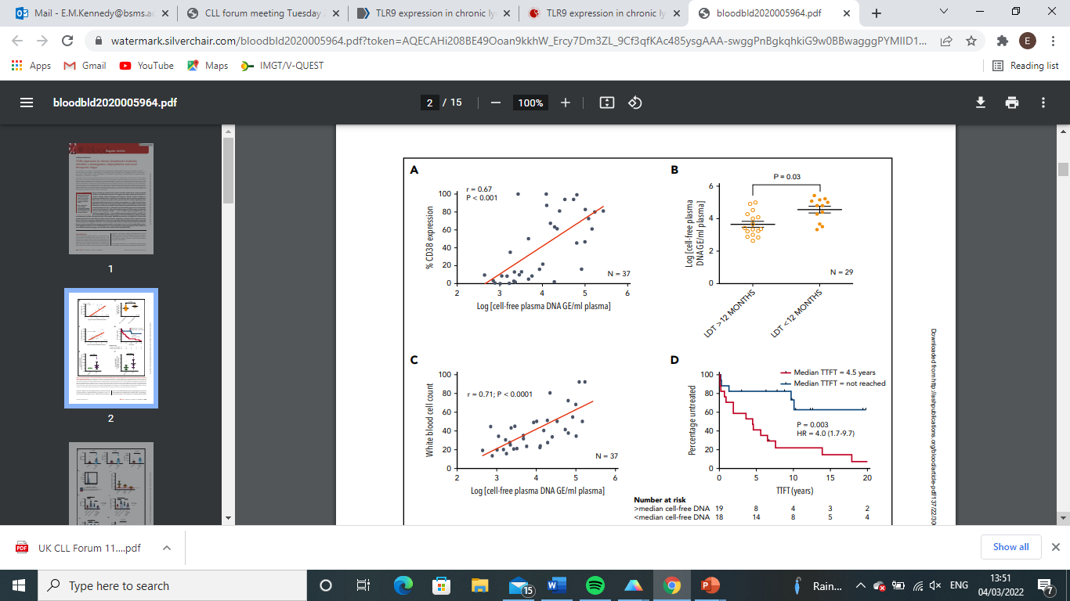
Cell-free DNA correlates with dynamic CLL markers
Aim 1
>12 months
<12 months
Lymphocyte Doubling Time
These data suggest an auto-stimulatory mechanism of TLR9 activation in patients with a high leukaemic burden.

Slide 7
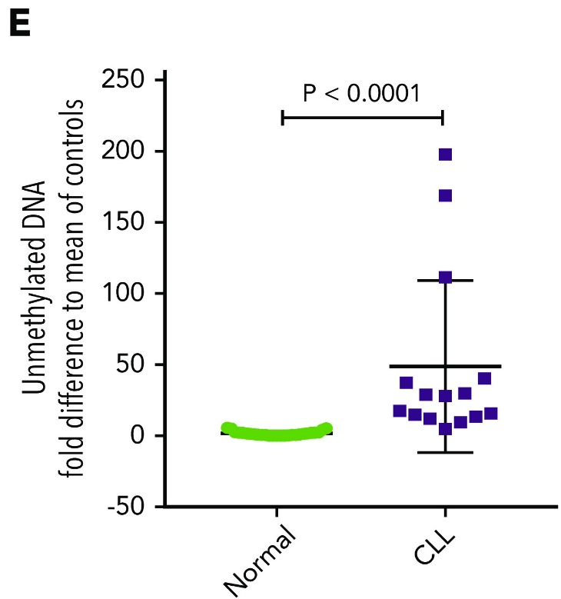
CLL patient plasma contains high concentrations of unmethylated DNA
Aim 1

Slide 8
Aim 2
Aim 1
To investigate the expression of TLR9 in CLL

Slide 9
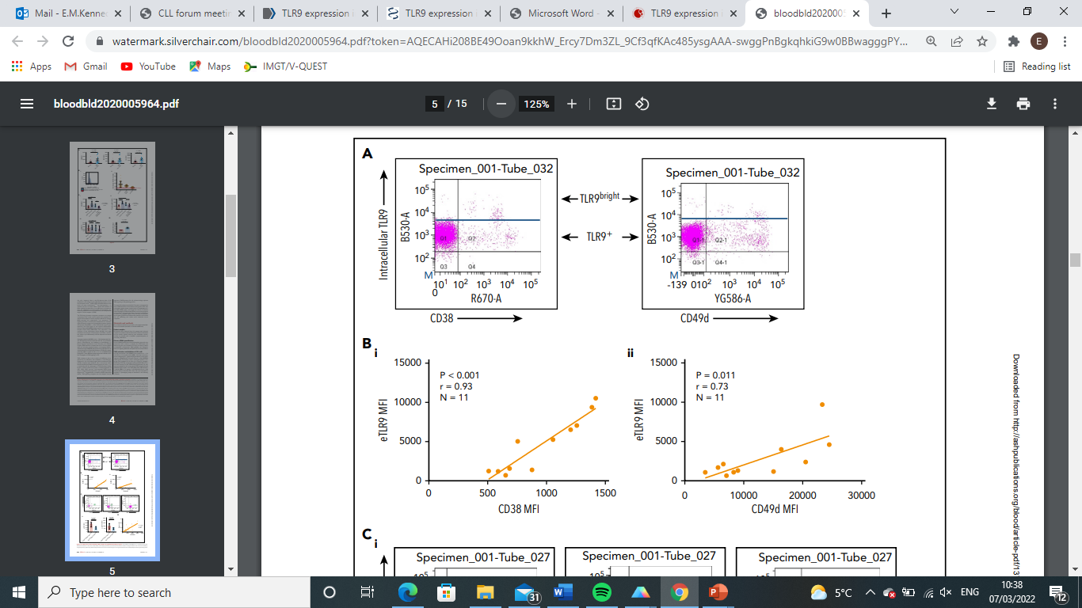
Aim 2
TLR9^{bright} cells express high levels of the migratory markers CD38/CD49d
Aim 1
TLR9^{bright}
TLR9⁺
Intracellular TLR9
Intracellular TLR9
CD38
CD49d
eTLR9 MFI
eTLR9 MFI
CD38 MFI
CD49d MFI

Slide 10
Aim 2
TLR9 is an intracellular receptor
Aim 1
CpG DNA
Endosome
Cell surface membrane

Slide 11
Aim 2
TLR9 trafficking
Aim 1
Surface TLR9
CpG DNA
Endosome
Secretory Vesicle
Golgi Apparatus
Endoplasmic Reticulum

Slide 12
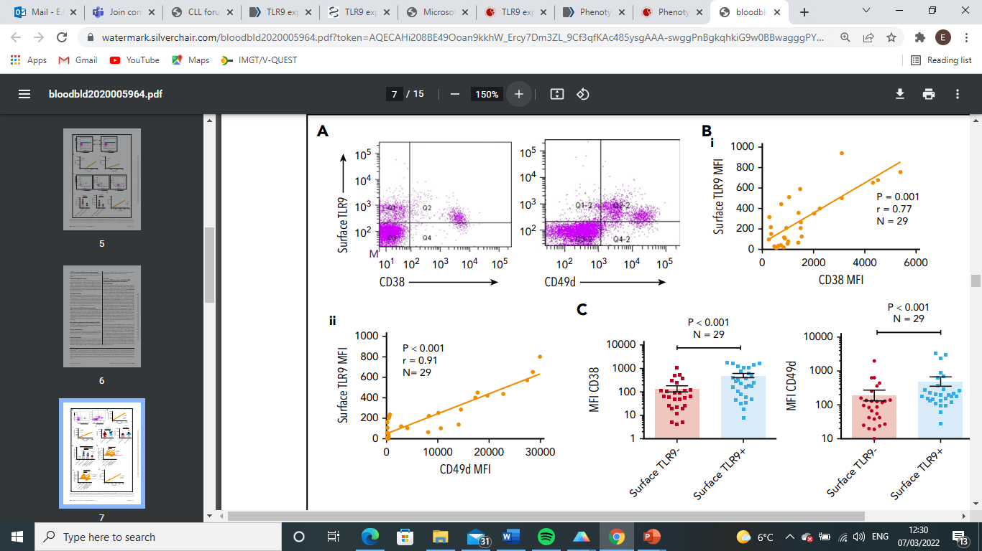
Aim 2
Surface TLR9 strongly correlates with CD38 and CD49d
Aim 1

Slide 13
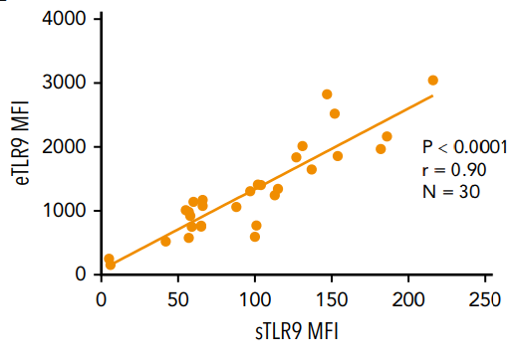
Aim 2
Surface TLR9 expression strongly correlates with endosomal TLR9 expression
Aim 1
….surface TLR9 = looks like a good marker of overall TLR9 expression/activation

Slide 14
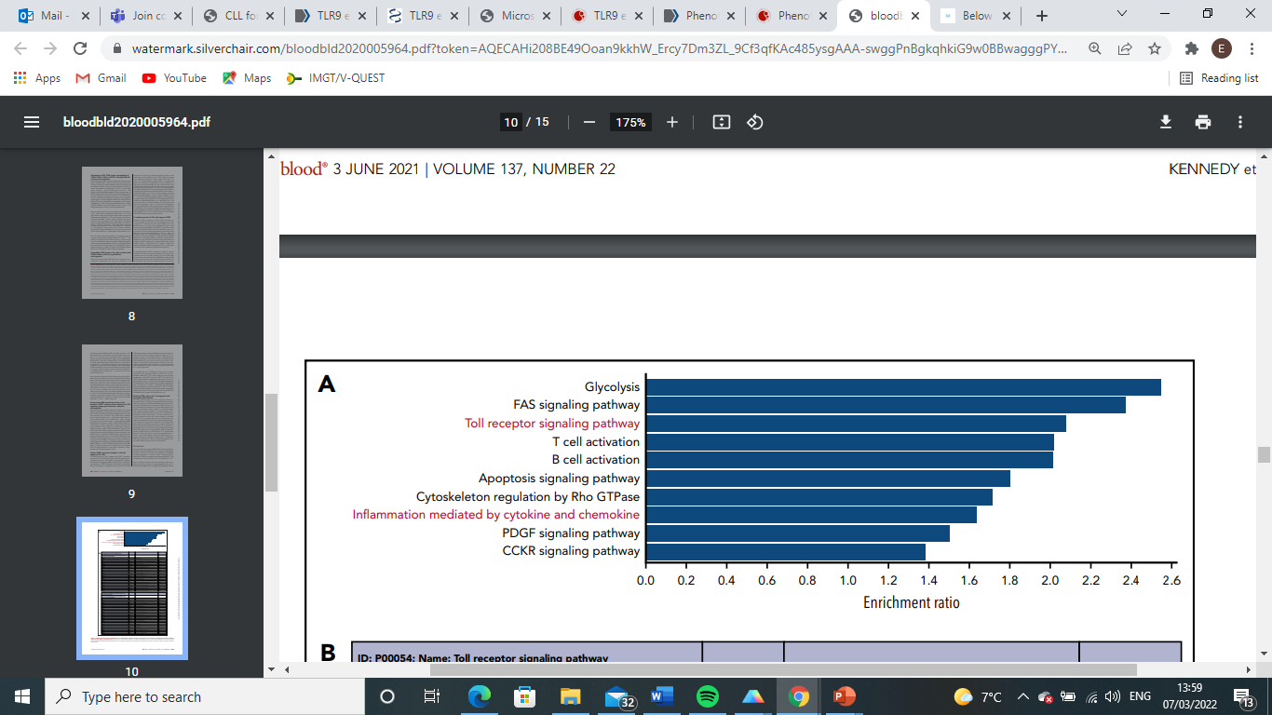
Aim 2
sTLR9^{hi} CLL cells have a pro-inflammatory and pro-migratory phenotype
Aim 1
Glycolysis
FAS signalling pathway
Toll-like receptor signalling pathway
T cell activation
B cell activation
Apoptosis signalling pathway
Cytoskeleton regulation by Rho GTPase
Inflammation mediated by cytokine and chemokine
PDGF signalling pathway
CCKR signalling pathway

Slide 15
Aim 2
sTLR9hi CLL cells overexpress TLR, NFκB, STAT3 and BCR-regulated genes
Aim 1
TLR:
IRAK4
NFκB:
NFKBIA
NFKBIE
RelA
NFKB2
IKBKB
TRAF6
STAT3:
JAK2
JunB
BCR:
PLCγ2

Slide 16
Aim 3
To investigate whether TLR9 activation induces an activated and migratory phenotype in primary CLL cells
TLR9 agonist: ODN 2006
(5’ tcg tcg ttt tgt cgt ttt gtc gtt 3’) -GC-rich 24-mer

Slide 17
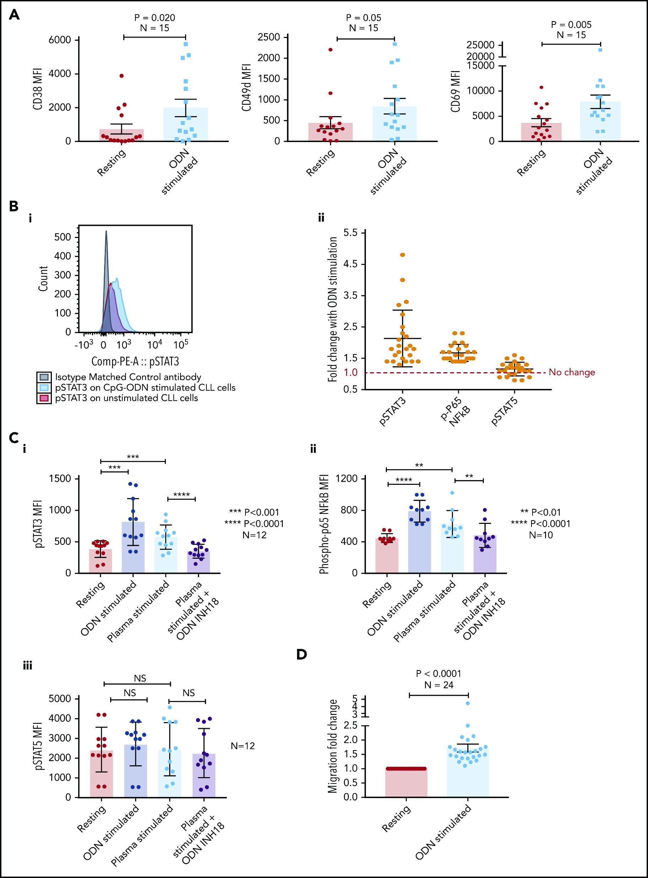
TLR9 activation induces the expression of B-cell activation and migration markers
Aim 3
CD49d MFI
CD69 MFI
CD38 MFI
Unstimulated
+ ODN 2006
Unstimulated
+ ODN 2006
Unstimulated
+ ODN 2006

Slide 18

TLR9 activation induces STAT3 and NFκB activation
Aim 3

Slide 19
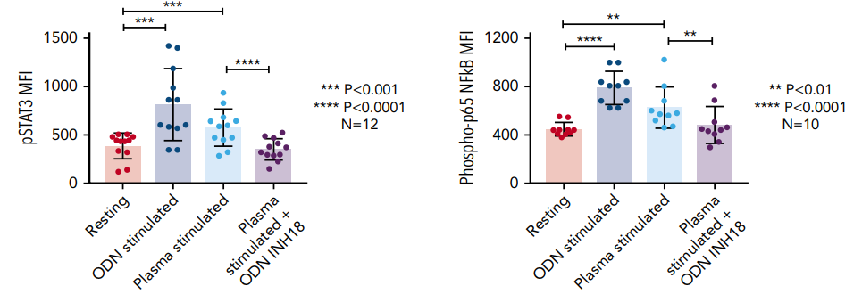
Autologous patient plasma induces STAT3 and NFκB activation
Aim 3

Slide 20
Autologous patient plasma induces STAT3 and NFκB activation
Aim 3
TLR9 antagonist: ODN INH-18
(5’ cct gga tgg gaa ctt acc gct gca 3’)

Slide 21
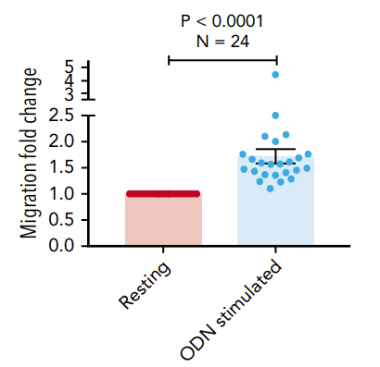
TLR9 activation promotes CLL cell migration
Aim 3
Top chamber
Non-Migrated
4h
Bottom chamber
(+ CXCL12)
Migrated

Slide 22
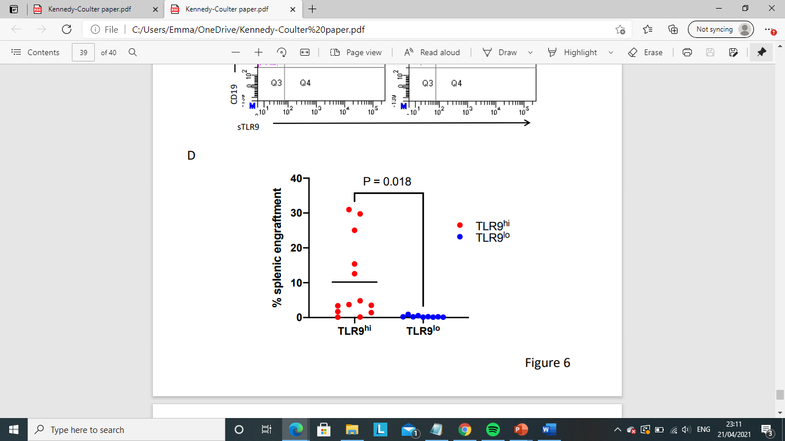
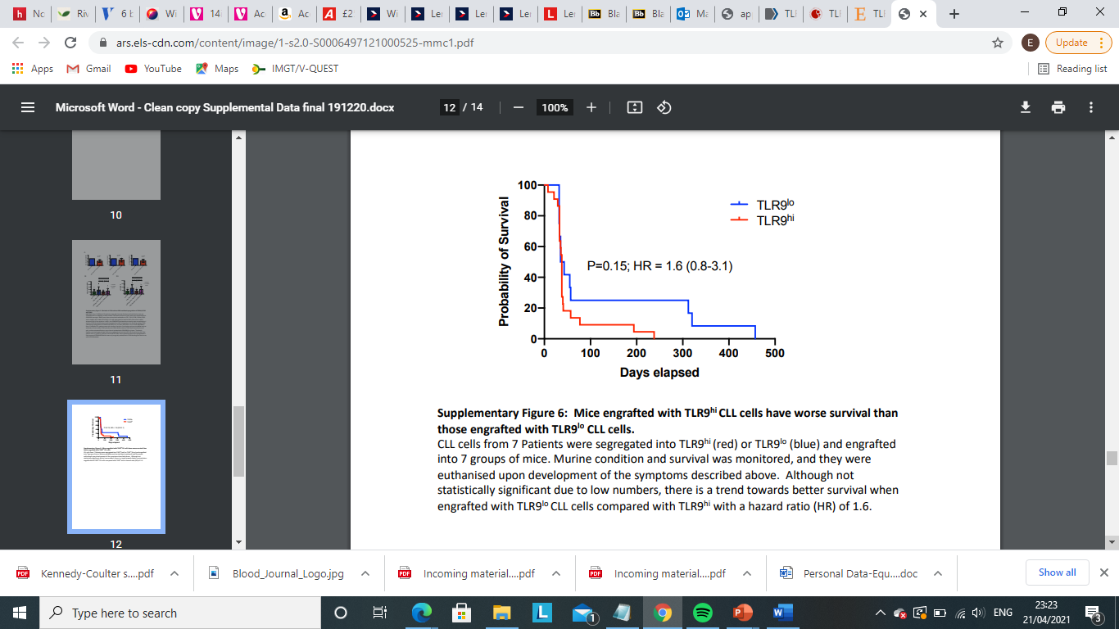
TLR9 expression is associated with splenic engraftment and poor survival
Aim 3
Murine xenograft model: NOD/Shi-scid/IL-2Rγ^{null}
Stankovic Team, University of Birmingham

Slide 23
Aim 4
To investigate dual inhibition of the TLR9 and BCR signalling pathways

Slide 24
TLR9 and BCR signalling
Aim 4
TLRs
BCR
TLR2
TLR4
CD79a
TLR6
TLR5
CD79b
Cell
membrane
TLR8
TLR3
BLNK
BTK
ibrutinib
TLR-Pathway
LYN
SYK
PLGC
TLR9
TLR7
BCR-Pathway
CARD11
MyD88
MALT1
BCL10
IRAK1
IRAK4
TRAF6
NF-𝛋B
Cell proliferation
Migration
Survival
IL-6
IL-10
JAK
STAT
Adapted from:
Akhter et al. Journal of Neuro-oncology 121, pages 289–296 (2015)

Slide 25
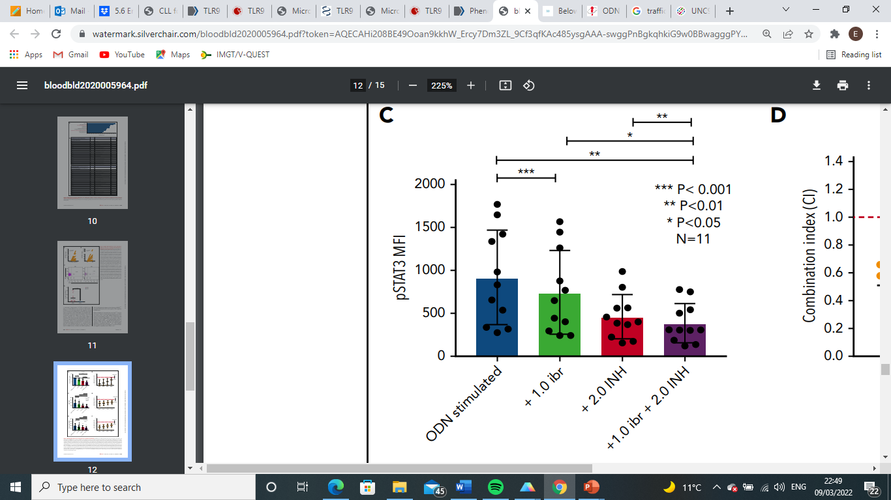
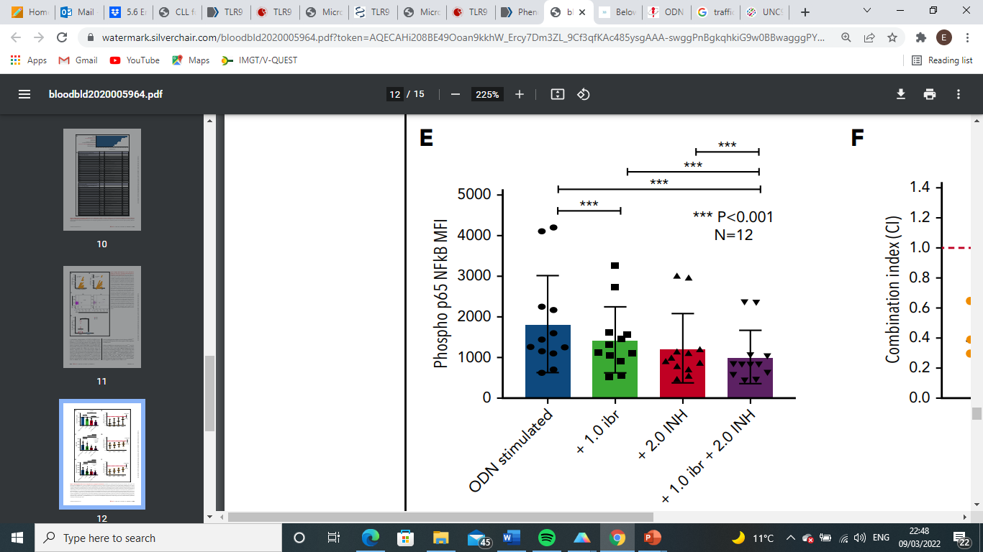
Synergistic inhibition of STAT3 and NFκB activation
Aim 4
pSTAT3 MFI
Phospho p66 NFκB MFI
Control
Control
Control
BTK inhibitor
BTK inhibitor + TLR9 inhibitor
BTK inhibitor
BTK inhibitor + TLR9 inhibitor
TLR9 inhibitor
TLR9 inhibitor

Slide 26
Synergistic inhibition of STAT3 and NFκB activation
Aim 4
pSTAT3 MFI
Phospho p66 NFκB MFI
Control
Control
Control
BTK inhibitor
BTK inhibitor + TLR9 inhibitor
BTK inhibitor
BTK inhibitor + TLR9 inhibitor
TLR9 inhibitor
TLR9 inhibitor

Slide 27
Synergistic inhibition of STAT3 and NFκB activation
Aim 4
pSTAT3 MFI
Phospho p66 NFκB MFI
Control
Control
Control
BTK inhibitor
BTK inhibitor + TLR9 inhibitor
BTK inhibitor
BTK inhibitor + TLR9 inhibitor
TLR9 inhibitor
TLR9 inhibitor

Slide 28
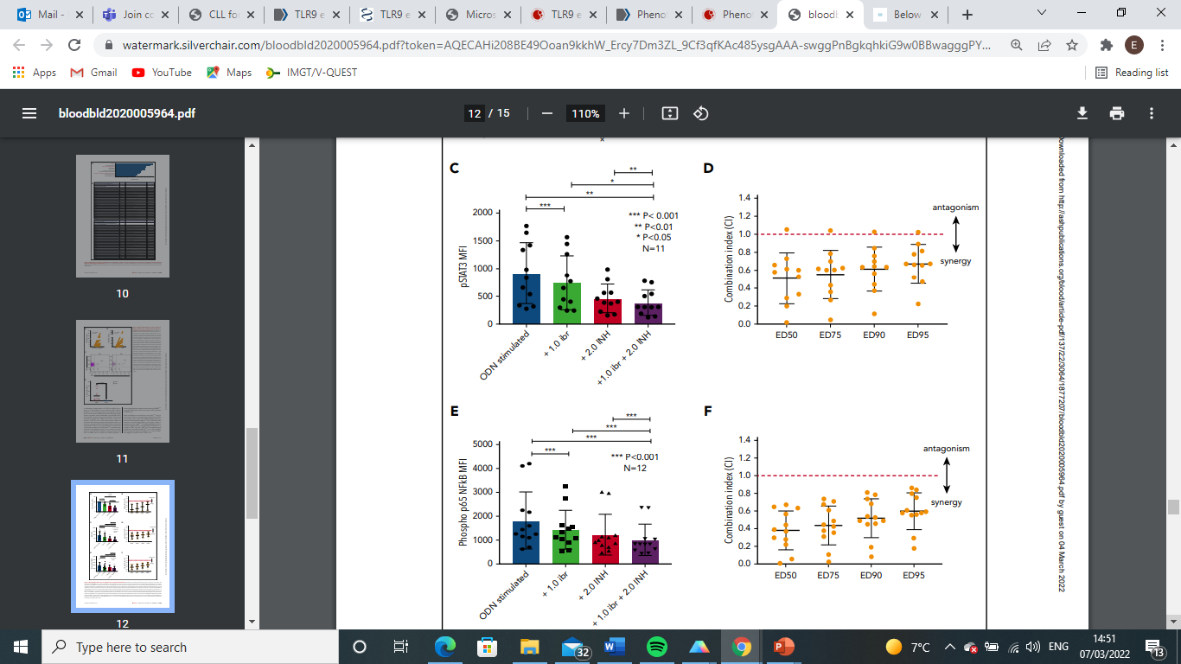
Synergistic inhibition of STAT3 and NFκB activation
Aim 4
pSTAT3
P65 (NFκB)
Combination index (CI)
Combination index (CI)

Slide 29
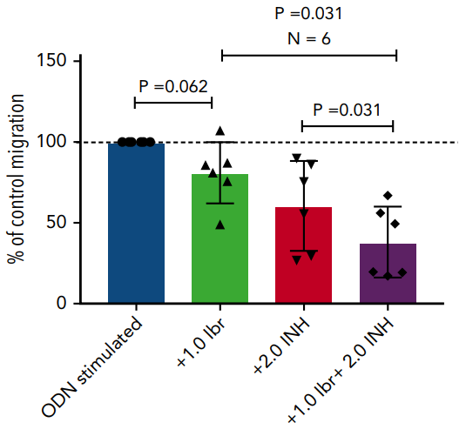
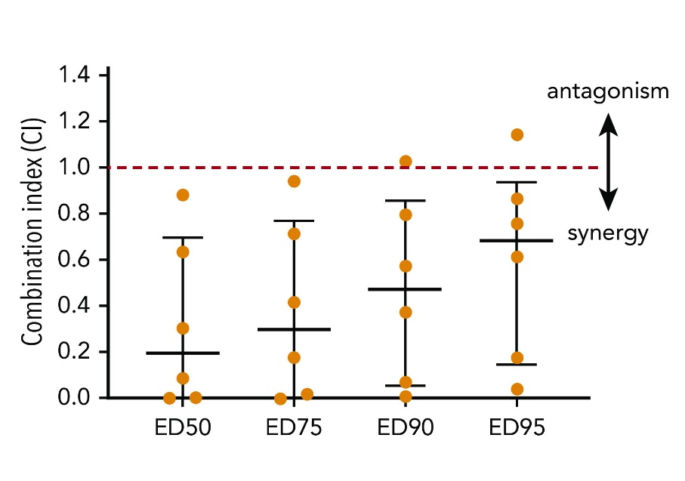
Aim 4
Synergistic inhibition of CLL cell migration
Migration
% of control migration
Combination index (CI)
Control
BTK inhibitor
BTK inhibitor + TLR9 inhibitor
TLR9 inhibitor

Slide 30
Summary
CLL patient plasma contains high levels of unmethylated DNA, which has the potential to promote TLR9 activation in vivo.
Surface TLR9 expression can be used as a tool to identify the most TLR9-active CLL cells.
Enhanced TLR9 signalling is associated with a pro-inflammatory and pro-migratory phenotype.
TLR9 activation induces an NF-κB and STAT3-driven activated and migratory phenotype.
TLR9 activation promotes CLL cell migration in vitro and splenic engraftment in vivo.
Dual inhibition of TLR9 and BCR signalling induces synergistic reductions in NF-κB and STAT3 activation and CLL cell migration
We therefore hypothesise that a TLR9/BCR dual targeted approach to therapy has the potential to achieve a more sustained clinical response to treatment.

Slide 31




Acknowledgements:
Brighton and Sussex
Medical school
Andrea Pepper
Chris Pepper
Tom Burley
Simon Mitchell
Eleni Ladikou
Kim Sharp
Tim Chevassut
Gemma Hamilton
Christopher Jones
BSUHT
Roz Johnston
Kat Chamberlain
Dora Bak Blaz
KCL/KCH
Marta Pasikowska
Emma Halliwell
Steve Devereux
Barnaby Clark
Elizabeth Phillips
Barts Cancer Institute
Eve Coulter
Josep Carreras Leukaemia
Research Institute
Nuria Profitos-Peleja
University of Birmingham
Tanja Stankovic
Angelo Agathanggelou
Ceri Oldreive
Nicholas Davies
University of Liverpool
Triantafillos Liloglou
University of Cardiff
Beth Walsby
Chris Fegan
German Cancer Research Center
Martina Seiffert
Ralph Schulz
Thank you to all the CLL patients who donated blood for our research

